Slide 1
Predicting Diabetes & Hospital Readmission:
A Two-Dataset Clinical Analysis
5100 Foundations of Data Science Group 8
By: Badamgarav Battushig, Naomi Le Mouel, Gurpreet Kaur

Slide 2
Agenda
Introduction
Data & Preparation
Diabetes Analysis
Background & Motivation
Problem Statement
Overview of Modeling Goals
Dataset Descriptions
Key Variables
Cleaning & Processing Steps
Summary Findings
ROC Curve (Model Performance)
Important Predictors
Readmission Analysis
Nonlinear Effects
Discussion & Conclusion
Summary Findings
ROC Curve (Model Performance)
Important Predictors
Nonlinear Modeling Findings
Understanding Nonlinear Trends
Cross-Dataset Comparison
Key Takeaways
Limitations
Future Directions
Conclusion

Slide 3
Introduction
Background & Motivation
Problem Statement
Purpose of the Analysis
Overview of Modeling Goals

Slide 4
Background & Motivation
Diabetes is common and can be identified early using clear clinical markers
Hospital readmission is an important quality metric but difficult to predict
Using two contrasting datasets helps explore why some outcomes are highly predictable and others are not
Dual-dataset design aligns with current research and supports transparent, reproducible analysis

Slide 5
Research Question
Question 1
Question 2
Question 3
Which clinical and demographic variables best predict diabetes?
What factors predict 30-day hospital readmission for diabetic patients?
Are there shared risk factors across these two outcomes?

Slide 6
Overview of Modeling Goals
Build predictive models for two related but distinct outcomes
Compare model behavior across clinical vs. hospital datasets
Identify key predictors that drive each outcome

Slide 7
Data Overview &
Preparation
Dataset Descriptions
Key Variables
Cleaning & Processing Steps

Slide 8
Data Overview
Dataset 1: Kaggle — 100,000 Diabetes Clinical Dataset
100k patients
16 variables
Target: diabetes (binary)
Dataset 2: UCI — Diabetes 130-US Hospitals (1999–2008)
101,766 encounters
47 variables
Target: 30-day readmission

Slide 9
Key Variables
Kaggle Diabetes Dataset (100,000 patients)
HbA1c level - long-term blood sugar indicator
Blood glucose level - current glucose measurement
BMI - body mass index
Age - demographic risk factor
Hypertension - comorbidity indicator
Heart disease - comorbidity indicator
Smoking history - lifestyle variable
Diabetes (target) - binary outcome
UCI Readmission Dataset (101,766 encounters)
Number of medications - treatment intensity
Time in hospital - hospitalization duration
Number of diagnoses - patient complexity
Prior inpatient visits - historical utilization
Outpatient & emergency visits - recent healthcare usage
Readmitted (target) - <30 days, >30 days, or no readmission

Slide 10
Data Cleaning & Preparation
Checked and handled missing values
Removed rows with invalid or missing target outcomes
Encoded categorical variables (one-hot)
Standardized numeric features for modeling
Excluded categorical variables from correlation analysis
Added nonlinear features (polynomials, interactions)

Slide 11
Diabetes Analysis
Summary Findings
ROC Curve (Model Performance)
Important Predictors

Slide 12
Diabetes Dataset: Key Findings
HbA1c & Glucose strongly separate diabetic vs non-diabetic groups
BMI and Age show increasing risk
Comorbidities: hypertension & heart disease more common in diabetic patients
Demographics show weak association with diabetes status

Slide 13
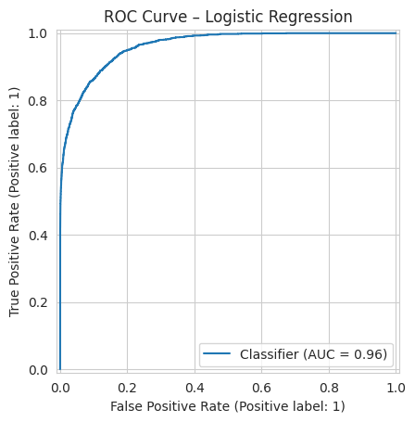
Diabetes Model Performance (ROC)
Logistic Regression AUC ≈ 0.96
Random Forest AUC also very high
Both models show strong discriminative ability

Slide 14
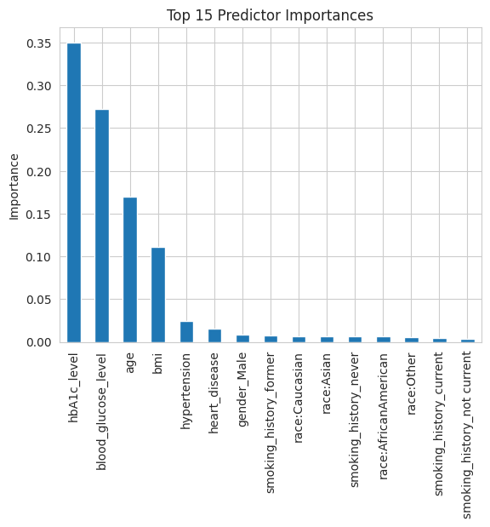
Diabetes: Important Predictors
Top predictors:
HbA1c
Blood glucose
Age
BMI
Hypertension
Heart disease

Slide 15
Readmission Analysis
Summary Findings
ROC Curve (Model Performance)
Important Predictors

Slide 16
Readmission Dataset: Key Findings
Distribution of readmission labels
Many categorical hospital features
Indicators of patient complexity (diagnoses, meds, inpatient visits)

Slide 17
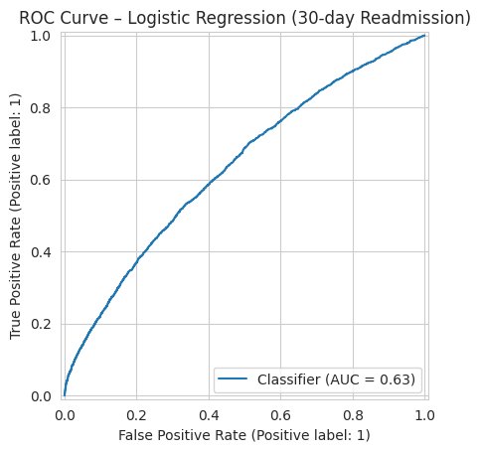
Readmission Model Performance (ROC)
Logistic Regression AUC ≈ 0.63
Much lower than diabetes models
Close to random guessing

Slide 18
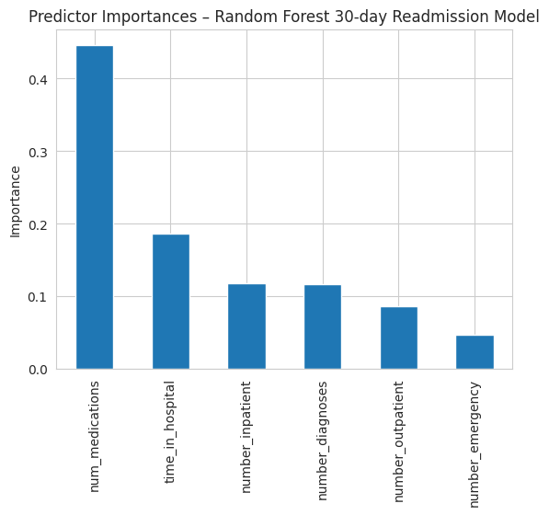
Readmission: Important Predictors
Top predictors:
Number of medications
Time in hospital
Prior inpatient visits
Number of diagnoses
Smaller influence:
Outpatient & emergency visits

Slide 19
Nonlinear Effects
Nonlinear Modeling Findings
Understanding Nonlinear Trends

Slide 20
Nonlinear Modeling Findings
Added squared versions of key variables
Helps model relationships that aren’t straight-line
HbA1c² and glucose² show meaningful curved effects
Medication count² and inpatient visits² improve readmission modeling
Captures accelerating or slowing risk patterns

Slide 21
Understanding Nonlinear Trends
Higher HbA1c values lead to sharper increases in diabetes risk
Glucose levels show a similar rising curve
Readmission predictors show leveling-off effects
Highlights thresholds where risk changes more dramatically
Improves interpretation even when accuracy doesn’t increase much

Slide 22
Discussion
&
Conclusion
Cross-Dataset Comparison
Key Takeaways
Limitations
Future Directions
Conclusion

Slide 23
Comparison Across Datasets
Diabetes: strong signals from clinical biomarkers
Readmission: weak predictability due to limited administrative data
Shared pattern: patient complexity increases risk
Modeling difficulty differs because datasets capture different types of information

Slide 24
Key Takeaways
Simple clinical measures can achieve strong diabetes prediction
Readmission prediction requires richer, more detailed data
Nonlinear terms help reveal important thresholds in risk
Data quality plays a bigger role than model complexity in both tasks

Slide 25
Implications & Limitations
Implications:
Simple clinical tests support early diabetes detection
Readmission prediction requires broader patient information
Limitations:
Missing social, behavioral, and follow-up care data
No temporal information on patient health
Results limited by available data

Slide 26
Future Directions
Incorporate richer clinical data (labs, vitals, medications)
Add social determinants of health (SDOH)
Explore deep learning or ensemble models
Improve readmission prediction with more complete hospital records

Slide 27
Conclusion
1. Which clinical factors predict diabetes?
Strong predictors: HbA1c, glucose, BMI, age
Hypertension & heart disease add moderate value
2. What predicts 30-day readmission?
Best predictors: number of medications, time in hospital, prior inpatient visits
Overall predictive power is low
3. Are there shared predictors across both outcomes?
General trend: the sicker or more complex the patient, the higher the risk
No strong overlapping variables due to weak readmission model performance

Slide 28
References
• Strack B, DeShazo JP, Gennings C, Olmo J L, Ventura S, Cios K J, Clore J. 2014. Impact of HbA1c measurement on hospital readmission rates: analysis of 70,000 clinical database patient records. BioMed Research International, 2014. VCU Scholars Compass+1
• Diabetes 130-US Hospitals for Years 1999-2008. UCI Machine Learning Repository (2014). UCI Machine Learning Repository+1
• 100,000 Diabetes Clinical Dataset. Kaggle (Choksi, 2023). Baselight+1
• Zarghani A. et al. 2024. Comparative Analysis of LSTM Neural Networks and Traditional Machine Learning Models for Predicting Diabetes Patient Readmission. arXiv. arXiv
• Sarthak, Shukla & Tripathi (2020). EmbPred30: Assessing 30-days Readmission for Diabetic Patients using Categorical Embeddings. arXiv. arXiv
• Hasan M., Yasmin F. 2025. Predicting Diabetes Using Machine Learning: A Comparative Study of Classifiers. arXiv.

Slide 29
THANK YOU

